Slide 1

PowerPoint to accompany
Introduction to MATLAB
for Engineers, Third Edition
William J. Palm III
Chapter 9
Numerical Methods for Calculus and Differential Equations
Copyright © 2010. The McGraw-Hill Companies, Inc. This work is only for non-profit use by instructors in courses for which this textbook has been adopted. Any other use without publisher’s consent is unlawful.

Slide 2
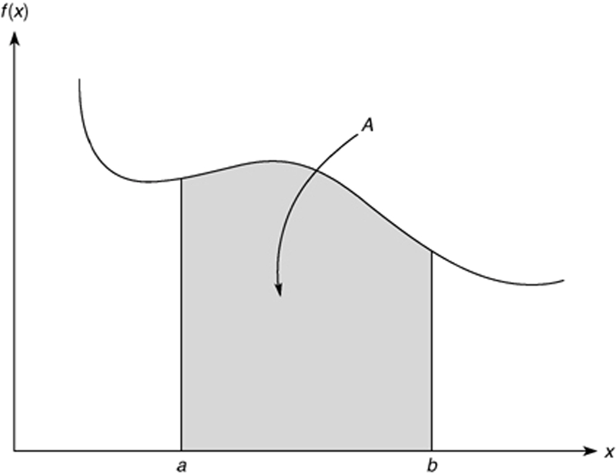
9-2
The integral of f(x) interpreted as the area A under the curve of f (x) from x = a to x = b.

Slide 3
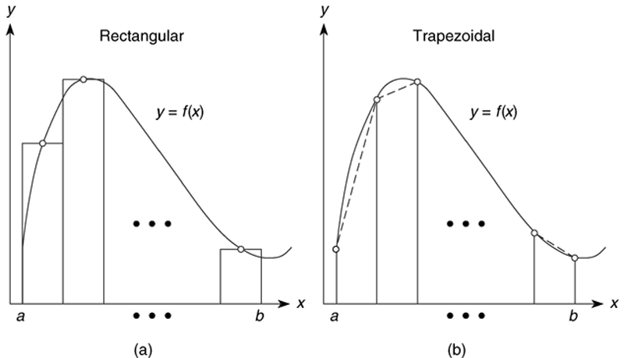
9-3
Illustration of (a) rectangular and (b) trapezoidal numerical integration. Figure 9.1–1, page 370.

Slide 4
9-4
Numerical integration functions. Table 9.1–1, page 371.
Command
quad(fun,a,b)
quadl(fun,a,b)
Description
Uses an adaptive Simpson’s rule to compute the integral of the function whose handle is fun, with a as the lower integration limit and b as the upper limit. The function fun must accept a vector argument.
Uses Lobatto quadrature to compute the integral of the function fun. The rest of the syntax is identical to quad.
(continued)

Slide 5
Table 9.1-1 (continued)
trapz(x,y)
Uses trapezoidal integration to compute the integral of y with respect to x, where the array y contains the function values at the points contained in the array x.
9-5

Slide 6
9-6
Although the quad and quadl functions are more accurate than trapz, they are restricted to computing the integrals of functions and cannot be used when the integrand is specified by a set of points. For such cases, use the trapz function.

Slide 7
9-7
Using the trapz function. Compute the integral
sin x dx
π
∫
0
First use 10 panels with equal widths of π/10. The script file is
x = linspace(0,pi,10);
y = sin(x);
trapz(x,y)
The answer is 1.9797, which gives a relative error of 100(2 - 1.9797)/2) = 1%. For more about the trapz function, see pages 371-373.

Slide 8
9-8
MATLAB function quad implements an adaptive version of Simpson’s rule, while the quadl function is based on an adaptive Lobatto integration algorithm.
To compute the integral of sin(x) from 0 to π, type
>>A = quad(@sin,0,pi)
The answer given by MATLAB is 2.0000, which is correct. We use quadl the same way; namely,
>> A = quadl(@sin,0,pi).

Slide 9
9-9
To integrate cos(x² ) from 0 to √(2π), create the function:
function c2 = cossq(x)
% cosine squared function.
c2 = cos(x.^2);
Note that we must use array exponentiation.
The quad function is called as follows:
>>quad(@cossq,0,sqrt(2*pi))
The result is 0.6119.
More? See pages 374-375.

Slide 10
Polynomial Integration
q = polyint(p,C)returns a polynomial q representing the integral of polynomial p with a user-specified scalar constant of integration C. See page 375.
Double Integrals
A = dblquad(fun, a, b, c, d) computes the integral of f(x,y) from x = a to b, and y = c to d. Here is an example using an anonymous function to represent f(x,y) = xy².
>>fun = @(x,y)x.*y^2;
>>A = dblquad(fun,1,3,0,1)
The answer is A = 1.3333. For more, see pages 376 to 377.
9-10

Slide 11
Triple Integrals
A = triplequad(fun, a, b, c, d, e, f) computes the triple integral of f(x,y, z) from x = a to b, y = c to d, and z = e to f. Here is an example using an anonymous function to represent f(x,y,z) = (xy -y²)/z.
>>fun = @(x,y,z)(x*y –y^2)/z;
>>A = triplequad(fun,1,3,0,2,1,2)
The answer is A = 1.8484. Note that the function must accept a vector x, but scalar y and z. See page 377.
9-11

Slide 12
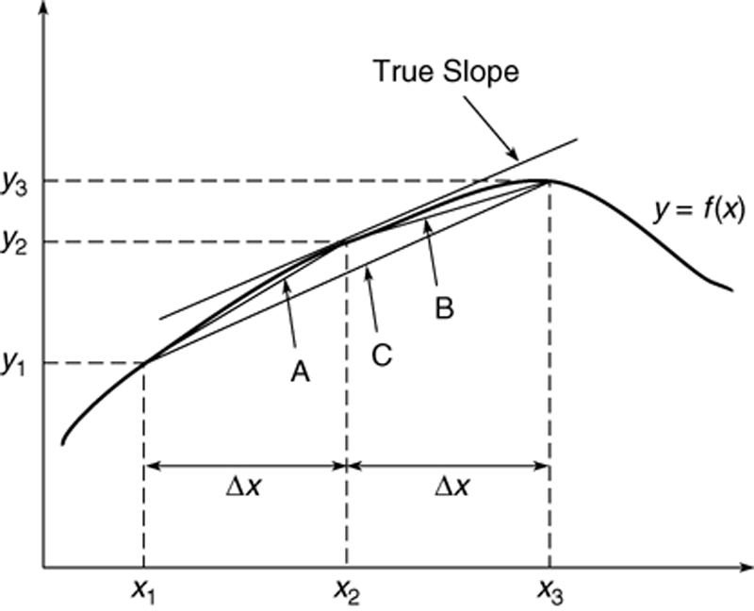
9-12
Numerical differentiation: Illustration of three methods for estimating the derivative dy/dx. Figure 9.2–1, page 378.

Slide 13
9-13
MATLAB provides the diff function to use for computing derivative estimates.
Its syntax is d = diff(x), where x is a vector of values, and the result is a vector d containing the differences between adjacent elements in x.
That is, if x has n elements, d will have n − 1 elements, where
d = [x(2) − x(1), x(3) − x(2), . . . , x(n) − x(n −1)].
For example, if x = [5, 7, 12, -20], then diff(x) returns the vector [2, 5, -32]. For more, see pages 377-379 and Table 9.2-1.

Slide 14
9-14
Polynomial differentiation functions from Table 9.2–1, page 382. For examples, see page 380.
Command
b = polyder(p)
b = polyder(p1,p2)
[num, den] = polyder(p2,p1)
Description
Returns a vector b containing the coefficients of the derivative of the polynomial represented by the vector p.
Returns a vector b containing the coefficients of the polynomial that is the derivative of the product of the polynomials represented by p1 and p2.
Returns the vectors num and den containing the coefficients of the numerator and denominator polynomials of the derivative of the quotient p₂/p₁, where p1 and p2 are polynomials.

Slide 15
Computing gradients
Typing
[df_dx, df_dy] = gradient(f,dx,dy)
computes the gradient of the function f(x,y), where df_dx and df_dy represent the partial derivatives, and dx, dy represent the spacing.
For an example, see Figure 9.2-2 and the program on pages 381-382.
9-15

Slide 16
Solving First-Order Differential Equations, Section 9.3.
The MATLAB ode solver, ode45. To solve the equation dy/dt = f(t,y) the syntax is
[t,y] = ode45(@ydot,tspan,y0)
where @ydot is the handle of the function file whose inputs must be t and y, and whose output must be a column vector representing dy/dt; that is, f(t,y). The number of rows in this column vector must equal the order of the equation. The array tspan contains the starting and ending values of the independent variable t, and optionally any intermediate values. The array y0 contains the initial values of y. If the equation is first order, then y0 is a scalar.
9-16

Slide 17
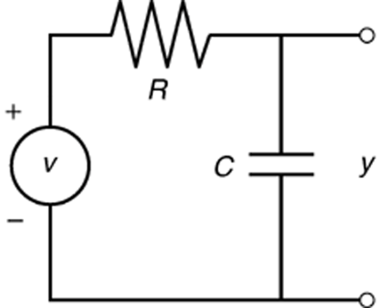
9-17
Application of an ode solver to find the response of an RC circuit . Figure 9.3-1, page 386.

Slide 18
9-18
The circuit model for zero input voltage v is
dy/dt + 10y = 0
First solve this for dy/dt:
dy/dt = −10y
Next define the following function file. Note that the order of the input arguments must be t and y.
function ydot = RC_circuit(t,y)
ydot = -10*y;

Slide 19
9-19
The function is called as follows, and the solution plotted along with the analytical solution y_true. The intial condition is y(0)=2.
[t, y] = ode45(@RC_circuit, [0, 0.5], 2);
y_true = 2*exp(-10*t);
plot(t,y,’o’,t,y_true),xlabel(’Time(s)’),...
ylabel(’Capacitor Voltage’)
Note that we need not generate the array t to evaluate y_true, because t is generated by the ode45 function.
The plot is shown on the next slide and in Figure 9.3-2 on page 387..

Slide 20
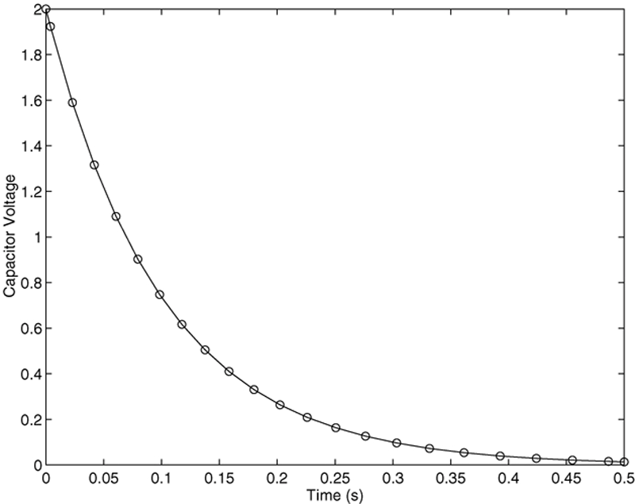
9-20
Free response of an RC circuit. Figure 9.3-2
More? See pages 498-500.

Slide 21
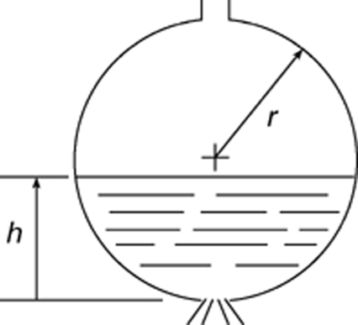
9-21
Application example: Draining of a spherical tank. Example 9.3-2 and Figure 9.3-3

Slide 22
The equation for the height is
First create the following function file.
function hdot = height(t,h)
Hdot = -(0.0344*sqrt(h))/(10*h-h^2);
This file is called as follows. The initial height is 9 ft.
[t,h] = ode45(@height, [0, 2475], 9);
plot(t,h),xlabel(‘Time(sec)’,ylabel(‘Height’(ft)’)
The plot is shown on the next slide.
9-22

Slide 23
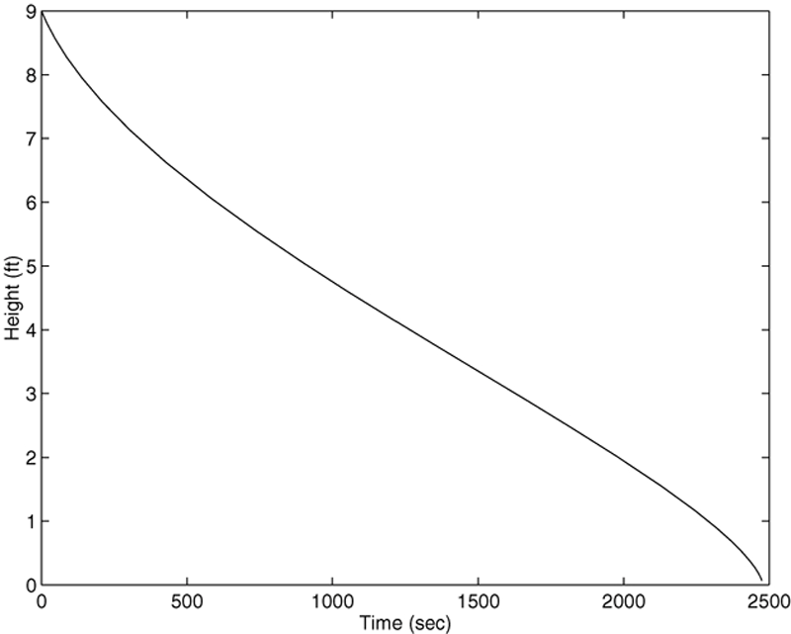
9-23
Plot of water height in a spherical tank. Figure 9.3-4, page 390.

Slide 24
9-24
Extension to Higher-Order Equations
Section 9.4, page 391
To use the ODE solvers to solve an equation higher than order 2, you must first write the equation as a set of first-order equations.

Slide 25
9-25
For example, consider the equation
(9.4-1)
Define x₁ = y and x₂ = dy/dt. Then the above equation can be expressed as two equations:
This form is sometimes called the Cauchy form or the state-variable form.

Slide 26
9-26
Suppose that f (t) = sin t. Then the required file is
function xdot = example_1(t,x)
xdot(1) = x(2);
xdot(2) = (1/5)*(sin(t)-4*x(1)-7*x(2));
xdot = [xdot(1); xdot(2)];
Note that:
xdot(1) represents dx₁/dt
xdot(2) represents dx₂/dt
x(1) represents x₁, and x(2) represents x₂.

Slide 27
9-27
Suppose we want to solve (9.4-1) for 0 ≤ t ≤ 6 with the initial conditions x₁(0) = 3, x₂(0) = 9 and f(t) = sin t. Then the initial condition for the vector x is [3, 9]. To use ode45, you type
[t, x] = ode45(@example_1, [0, 6], [3, 9]);

Slide 28
9-28
Each row in the vector x corresponds to a time returned in the column vector t. If you type plot(t,x), you will obtain a plot of both x₁ and x₂ versus t.
Note that x is a matrix with two columns; the first column contains the values of x₁ at the various times generated by the solver. The second column contains the values of x₂.
Thus to plot only x₁, type plot(t,x(:,1)).

Slide 29
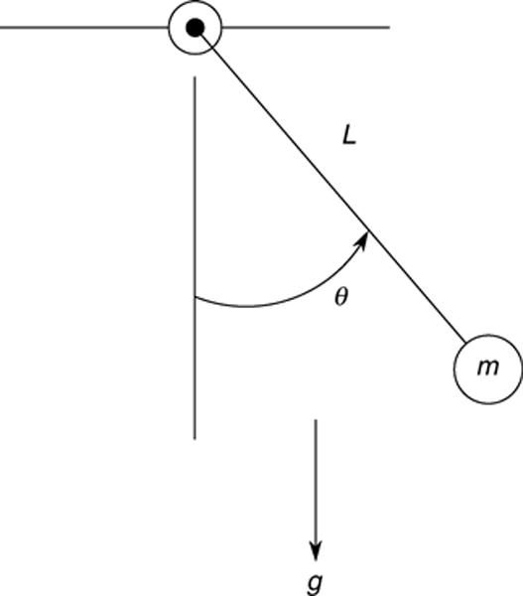
9-29
A pendulum example. Example 9.4-1, Figure 9.4-1, page 392

Slide 30
The equation (9.4-3) is nonlinear and is
It must be rewritten as follows to use ode45.
9-30

Slide 31
Create the following function file. Note how we can express xdot as a vector in one line, instead of two.
function xdot = pendulum(t,x)
g = 9.81; L = 1;
xdot = [x(2); -(g/L)*sin(x(1))];
The file is called as follows for the case where θ(0)=0.5 rad and the initial angular velocity is zero.
[t, x] = ode45(@pendulum, [0, 5], [0.5, 0];
plot(t,x(:,1))
The plot is shown by the curve labeled Case 1 on the next slide. See page 392 for how to plot the second case.
9-31

Slide 32
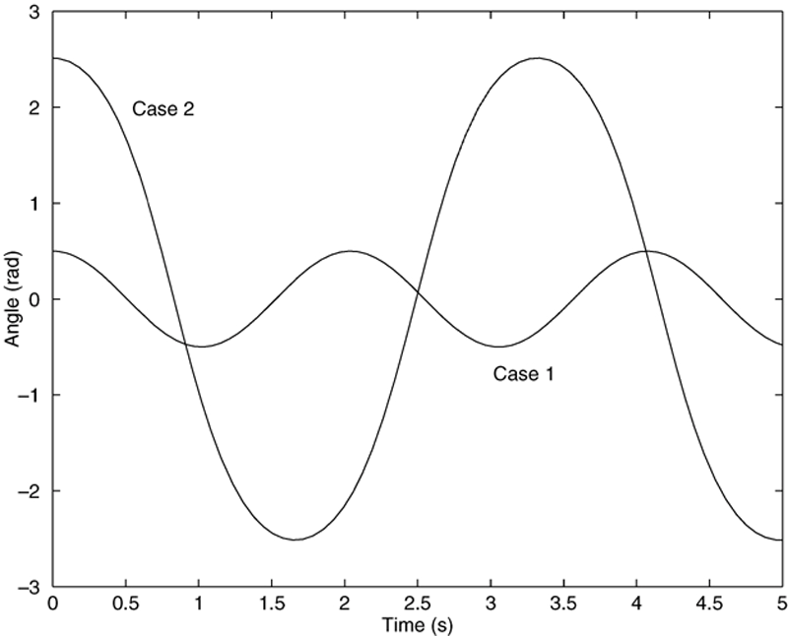
9-32
The pendulum angle as a function of time for two starting positions. Figure 9.4-2, page 393.
More? See pages 391-394.

Slide 33
The program on pages 393-394 shows how to use a nested function to avoid specifying the values of g and L within the function file pendulum.
9-33

Slide 34
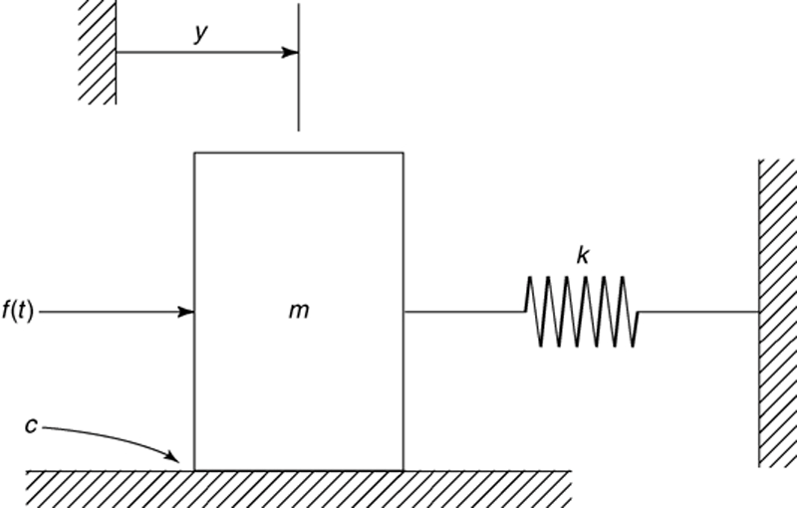
9-34
A mass and spring with viscous surface friction. Its equation of motion is

Slide 35
Section 9.5. Special Methods for Linear Differential Equations
The equation of motion can be put into the following state variable form.
These can be put into matrix form as shown on the next slide.
9-35

Slide 36
9-36

Slide 37
Create the following function file. function xdot = msd(t,x) f = 10; m = 1; c = 2; k = 5;
A = [0, 1;-k/m, -c/m];
B = [0; 1/m]; xdot = A*x + b*f;
The equations can be solved and the solution plotted follows.
[t, x] = ode45(@msd, [0, 5], [0, 0]; plot(t, x(:,1), t, x(:,2))
The plot is shown on the next slide.
9-37

Slide 38
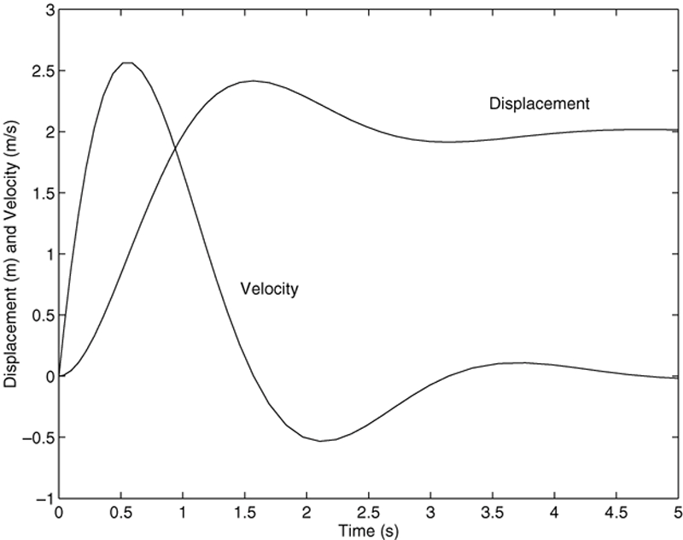
9-38
Displacement and velocity of the mass as a function of time.
Figure 9.5-1 on page 397.
More? See pages 395-396.

Slide 39
ODE Solvers in the Control System Toolbox, page 398.
Transfer function form: It is created by typing tf(right, left) where the vector right contains the coefficients on the right side of the equation and the vector left contains the coefficients on the left side. Consider the equation (9.5-10).
You create the transfer function model form named sys1 by typing
sys = tf([5, 1],[5, 7, 5]); You can plot the free response for the initial conditions 5 and -2 by typing
initial(sys, [5, -2])
You can plot the unit step response for zero initial conditions by typing step(sys1). See pages 399 – 402 and Tables 9.5-1 and 9.5-2 for more information about the tf, initial, and step functions.
9-39

Slide 40
9-40
LTI object functions. Table 9.5–1 on page 400.
Command
sys = ss(A, B, C, D)
[A, B, C, D] = ssdata(sys)
sys = tf(right,left)
[right, left] = tfdata(sys)
Description
Creates an LTI object in state-space form, where the matrices A, B, C, and D correspond to those in the model dx/dt = Ax + Bu, y = Cx + Du.
Extracts the matrices A, B, C, and D corresponding to those in the model dx/dt = Ax + Bu, y = Cx + Du.
Creates an LTI object in transfer-function form, where the vector right is the vector of coefficients of the right-hand side of the equation, arranged in descending derivative order, and left is the vector of coefficients of the left-hand side of the equation, also arranged in descending derivative order.
Extracts the coefficients on the right- and left-hand sides of the reduced-form model.

Slide 41
9-41
Basic syntax of the LTI ODE solvers. Table 9.5–2 on page 401.
Command
impulse(sys)
initial(sys,x0)
lsim(sys,u,t)
step(sys)
Description
Computes and plots the unit-impulse response of the LTI object sys.
Computes and plots the free response of the LTI object sys given in state-model form, for the initial conditions specified in the vector x0.
Computes and plots the response of the LTI object sys to the input specified by the vector u, at the times specified by the vector t.
Computes and plots the unit-step response of the LTI object sys.

Slide 42
The state variable form can be created with the ss function. Consider the model
Create the state space model sys for m = 2, c = 5 and k = 3, and plot the unit step response of the first variable by typing
m = 2; c = 5; k = 3;
A = [0, 1;-k/m, -c/m];B = [0; 1/m];
C = [1,0]; D = 0;
sys = ss(A,B,C,D);step(sys)
See pages 399 – 402 and Table 9.5-1 for more information about the ss function.
9-42

Slide 43
The impulse function computes and plots the impulse response. The lsim function computes and plots the solution for a user-defined input function. Both can be used with either the transfer function or the state variable forms. See Table 9.5-2 on page 401. Here is an example for the following equation with f(t) = 10 sin 3t and y(0)=2 for t =0 to t = 10.
sys = tf(1,[5,7,4]);
t = linspace(0,10,500);
f = 10*sin(3*t);
lsim(sys,f,t,2)
9-43
See pages 402 – 407 for more information.

Slide 44
The command initial(sys,x0)computes and plots the free response of the LTI object sys given in state-model form, for the initial conditions specified in the vector x0. For example,
m = 2; c = 5; k = 3;
A = [0, 1;-k/m, -c/m];B = [0; 1/m];
C = [1,0]; D = 0;
sys = ss(A,B,C,D);
initial(sys, [5, -2])
The response is shown on the next slide.
9-44

Slide 45
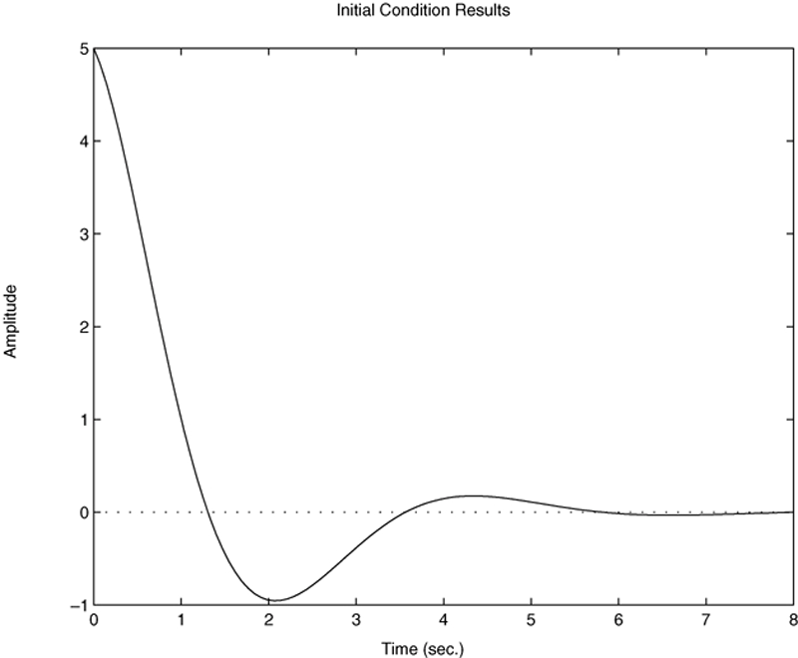
9-45
Free response of the model given by (9.5-5) through (9.5-8) for x₁(0) = 5 and x₂(0) = −2. Figure 9.5-2 on page 401.

Slide 46
Predefined Input Functions (pages 407-408)
The gensig function makes it easy to construct
periodic input functions. The syntax is
[u,t] = gensig(type, period)
where type can be ‘sin’, ‘square’, or ‘pulse’ and
period is the desired period of the input. The
vector t contains the times and the vector u contains
the input values at those times. The next slide gives
an example using a square wave,
9-46

Slide 47
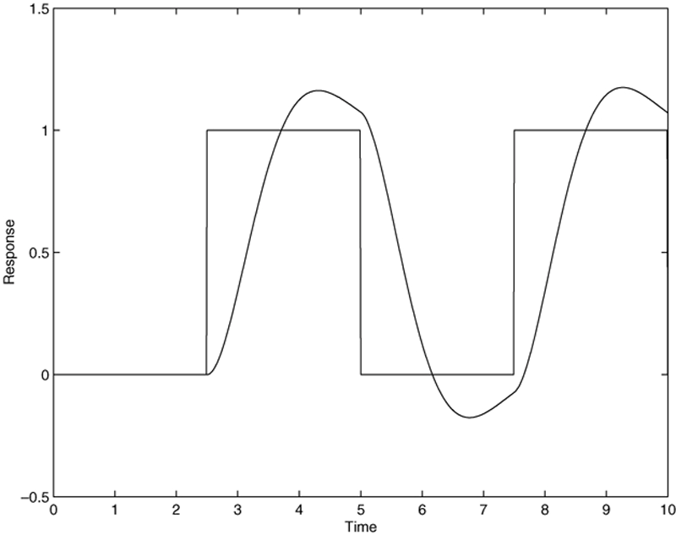
9-47
.
¨
Square-wave response of the model x + 2x + 4x = 4f.
Figure 9.5-6 on page 408.

